Slide 1

Lego
Box
Recognition
COMP6206
Advanced Computer Vision
Yaopengfei Lyu 27921832
Li Sun 27546432
Zhenyu Chen 27520129
Lei Zhang 27678385

Slide 2
Flow Chart
Lego Logo Detection & Anti-distortion
Information Cropped
De-noise and Thresholding
Optical Character Recognition(OCR)
CNN Training Dataset
CNN Predict
Combine Result
Box Number Identified

Slide 3
Library Used
opencv 3.0

Slide 4
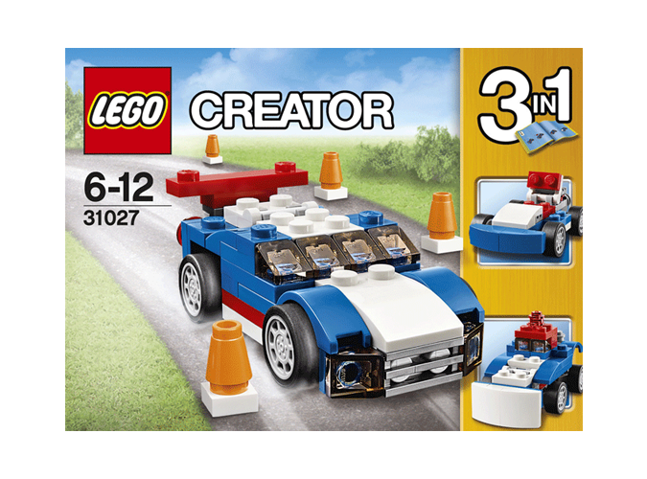

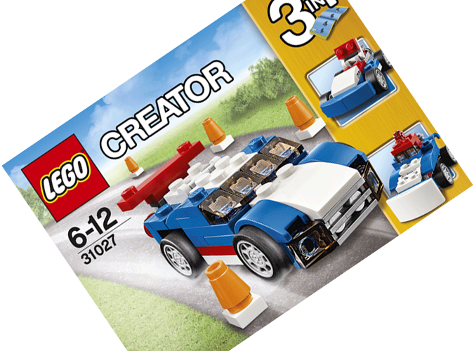
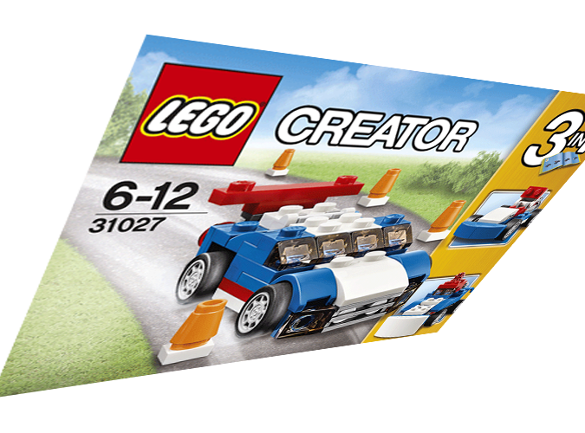
Image Preprocessing
Standard form
Scaling change
Rotation
Perspective transform
We use image preprocessing to recover the shooting box to standard form from any shooting angle and extract the area of the number.
Area of number is the area under the logo in the image.
Standard form was defined as the box surface parallel with the shooting camera and the texts are normal morphology in the image.

Slide 5
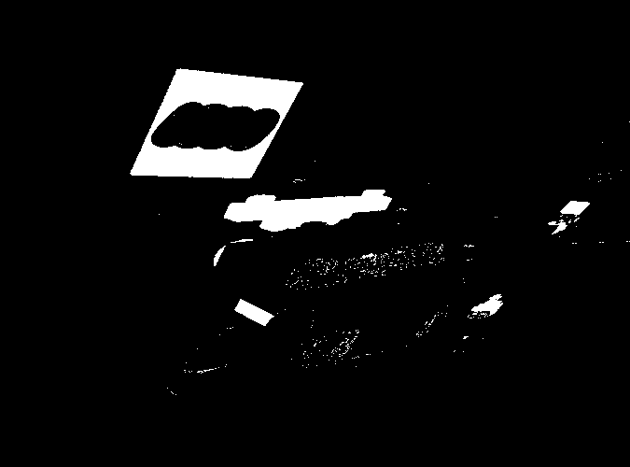
Image Preprocessing
Step1: Using HSV color space to find the red area in the image. The result is a mask.

Slide 6
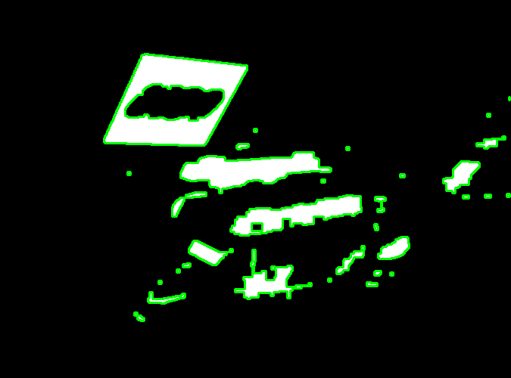
Image Preprocessing
Step 2: Finding all contours from the mask.

Slide 7
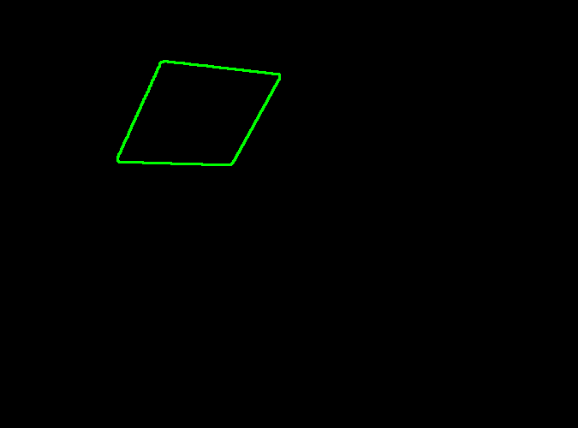
Image Preprocessing
Step 3: Picking the biggest quadrilateral from the contours by some geometric attribution.

Slide 8
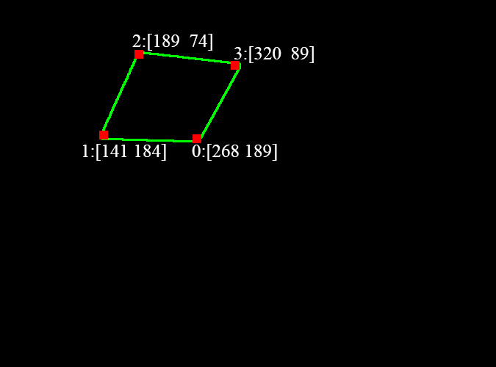
Image Preprocessing
Step 3: Detecting the four corners by Harris method. It could also verify the contour is a quadrilateral.

Slide 9
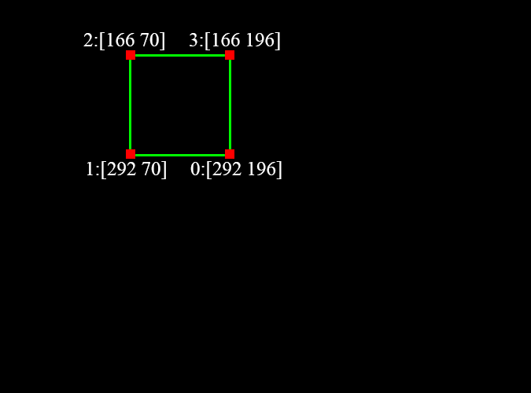
Image Preprocessing
Step 4: Creating a standard square preparing for affine transform.

Slide 10

Image Preprocessing

Slide 11
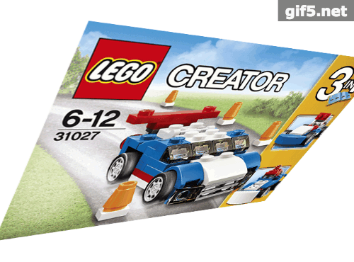
Image Preprocessing

Slide 12
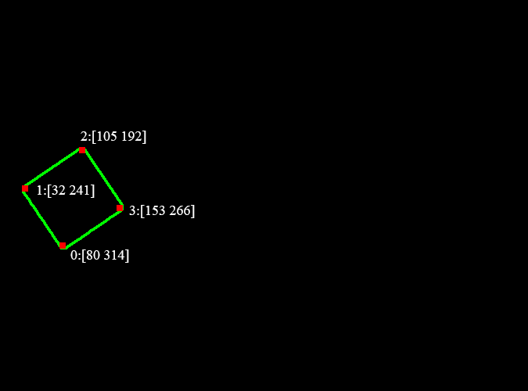
Image Preprocessing

Slide 13
Image Preprocessing
2
1
0
3

Slide 14
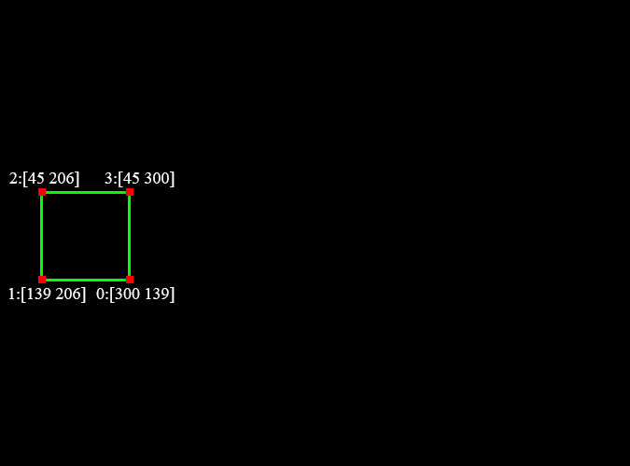
Image Preprocessing
2
1
0
3

Slide 15
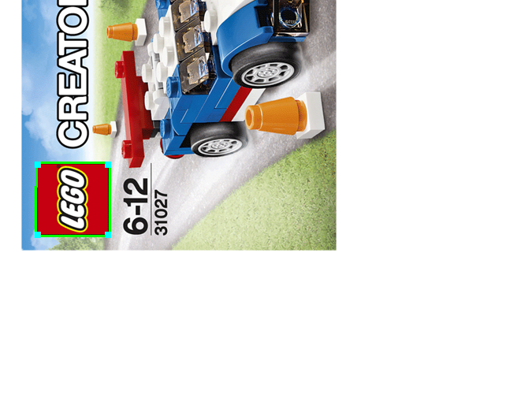
Image Preprocessing
2
1
0
3

Slide 16

Image Preprocessing

Slide 17
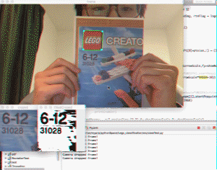

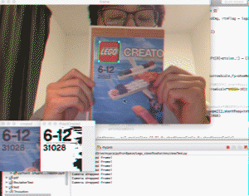
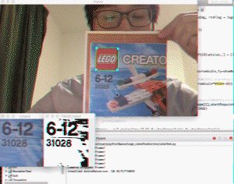
Image Preprocessing
Scaling
Rotation
Perspective
transform
Figx. Implementing result

Slide 18
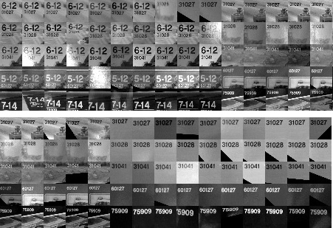
CNN Training dataset
5 boxes,
each has 6 image sides
300 pictures per boxes,
totally 1500.
Testing dataset also
created as 100 pictures
per box

Slide 19
Convolutional Neuron Network
30*30
28*28*32
14*14*32
12*12*32
6*6*32
512
256
128
64
5
Input
Convolution1
by 3*3
Maxpool
subsampling
by 2*2
Convolution2
by 3*3
Maxpool
subsampling
by 2*2
Fully
Connecting
Neurons

